Slide 1

Enhancing Search Engine Relevance for Video Subtitles
Team ID : T211124
Intern ID : IN1240335

Slide 2
Agenda
Business Problem
In today's world of online content, good search engines are super important for helping people find what they need. For Google, making sure their search works well is really important. This project is all about making video subtitles easier to find when you're searching, so everyone can enjoy videos more easily.
Objective
The main aim is to use natural language processing and machine learning to improve the accuracy and relevance of search results. My focus is on building a Semantic Search Engine here in this project.

Slide 3
Summary of the Data
The database, stored in a file named 'eng_subtitles_database.db', comprises a sample of 82,498 subtitle files sourced from opensubtitles.org.
These subtitles predominantly correspond to movies and TV series released between 1990 and 2024.
Each subtitle file is uniquely identified by a reference ID labeled 'num', which can be used to retrieve additional details from opensubtitles.org via the link format: https://www.opensubtitles.org/en/subtitles/{num}.
The database consists of a single table named 'zipfiles', containing three columns:
'num' for the unique subtitle ID
'name' for the subtitle file name
'content' for the compressed subtitle content encoded in 'latin-1' format.

Slide 4
Types of Search Engines
Keyword Based Search Engines:
Keyword-based search engines operate by matching exact keywords between user queries and indexed documents. They rely on direct matches to retrieve relevant results.
Semantic Search Engines:
Unlike keyword-based search engines, semantic search engines analyze the meaning and context of both user queries and documents. They aim to understand the intent behind the query and the content of the documents, allowing for more nuanced and relevant search results.
“Semantic search engines strive to offer more relevant and meaningful search results by considering the broader context surrounding the query.”

Slide 5
Workflow
Part 1 : Ingesting Documents
Reading the data
Reading the tables from the database (zipfiles table)
Reading the columns of the table (num, name, content)
Loading the Database into a Pandas Dataframe
Decoding the entire ‘content’ column from the dataframe
Choosing random 30000 samples from the dataframe to work with
Preprocessing the subtitle content
Removing timestamps
Removing website links
Removing special characters
Lowercase Conversion
Tokenization
Lemmetization
Joining the tokens back to get the cleaned form of the subtitle content

Slide 6
Workflow (contd.)
Part 1 : Ingesting Documents
Chunking the subtitle content
Chunking the subtitle content such that each of the chunks for a subtitle file has 100 tokens with an overlapping window of 50 tokens
4. Vectorization
Experimenting different vectorization techniques on the cleaned chunked subtitle content like
TF-IDF (helpful for keyword based search engine where exact match finding is used)
BoW (helpful for keyword based search engine)
Bert Based Sentence Transformer ( used model – ‘all-MiniLM-L6-v2’) (helpful for semantic search engine as it extracts semantic information)
5. Creating a ChromaDB collection
The created bert embeddings along with their respective file ids and their names are stored in a ChromaDB (a Vector Database) collection for future file retrievals (Note: TF-IDF/BoW can be inserted into the collection for Keyword Based Search Engine)
The similarity measure is set up to be cosine similarity for the collection

Slide 7
Workflow (contd.)
Part 2 : Retrieving Documents
User’s search query is preprocessed using the same function used to preprocess the subtitle files.
Embedding of the preprocessed query is generated using the same vectorization method used on the subtitle files.
In this case, since a Semantic Search Engine is created, Bert based Sentence Transformer is used.
Cosine distance is computed to derive the similarity scores between embeddings of documents and user search query embedding.
Top 10 results, that is, documents with the highest 10 similarity scores are retrieved for the user’s query.

Slide 8
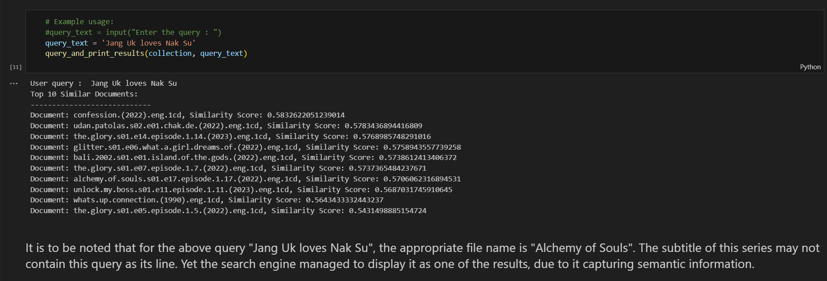
Results
Without the usage of a streamlit app

Slide 9
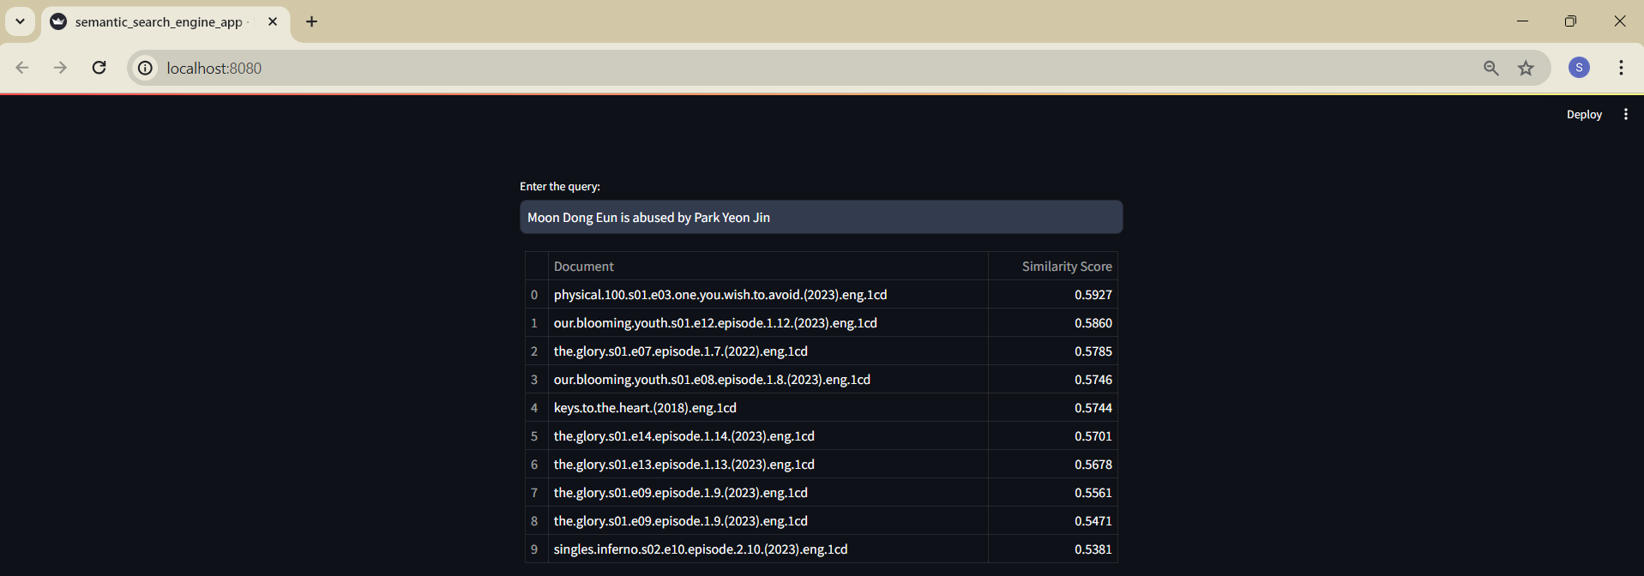
Results
Using streamlit app

Slide 10
Conclusion
Though the search results may not be highly accurate, the search engine implemented in this project still retrieves documents with similarity scores between 0.5 and 0.6 from which the correct document with respect to the user query is present.
In conclusion by delving into the nuanced meaning and context of user queries and documents, semantic search engines offer more relevant and meaningful search results, ultimately enhancing the user experience and facilitating deeper comprehension of information.

Slide 11

THANK YOU

